Slide 1


XBOX VS PS5
Matthew Leong, Siddhant Chauhan, Chirag Ramesh, Grayson Taylor,
David Cruz (Afternoon Cohort)

Slide 2
01
02
03
PROBLEM
DATA SOURCE
PRE-PROCESSING
TABLE OF CONTENTS
04
05
06
ANALYSIS
RESULTS
INSIGHTS

Slide 3
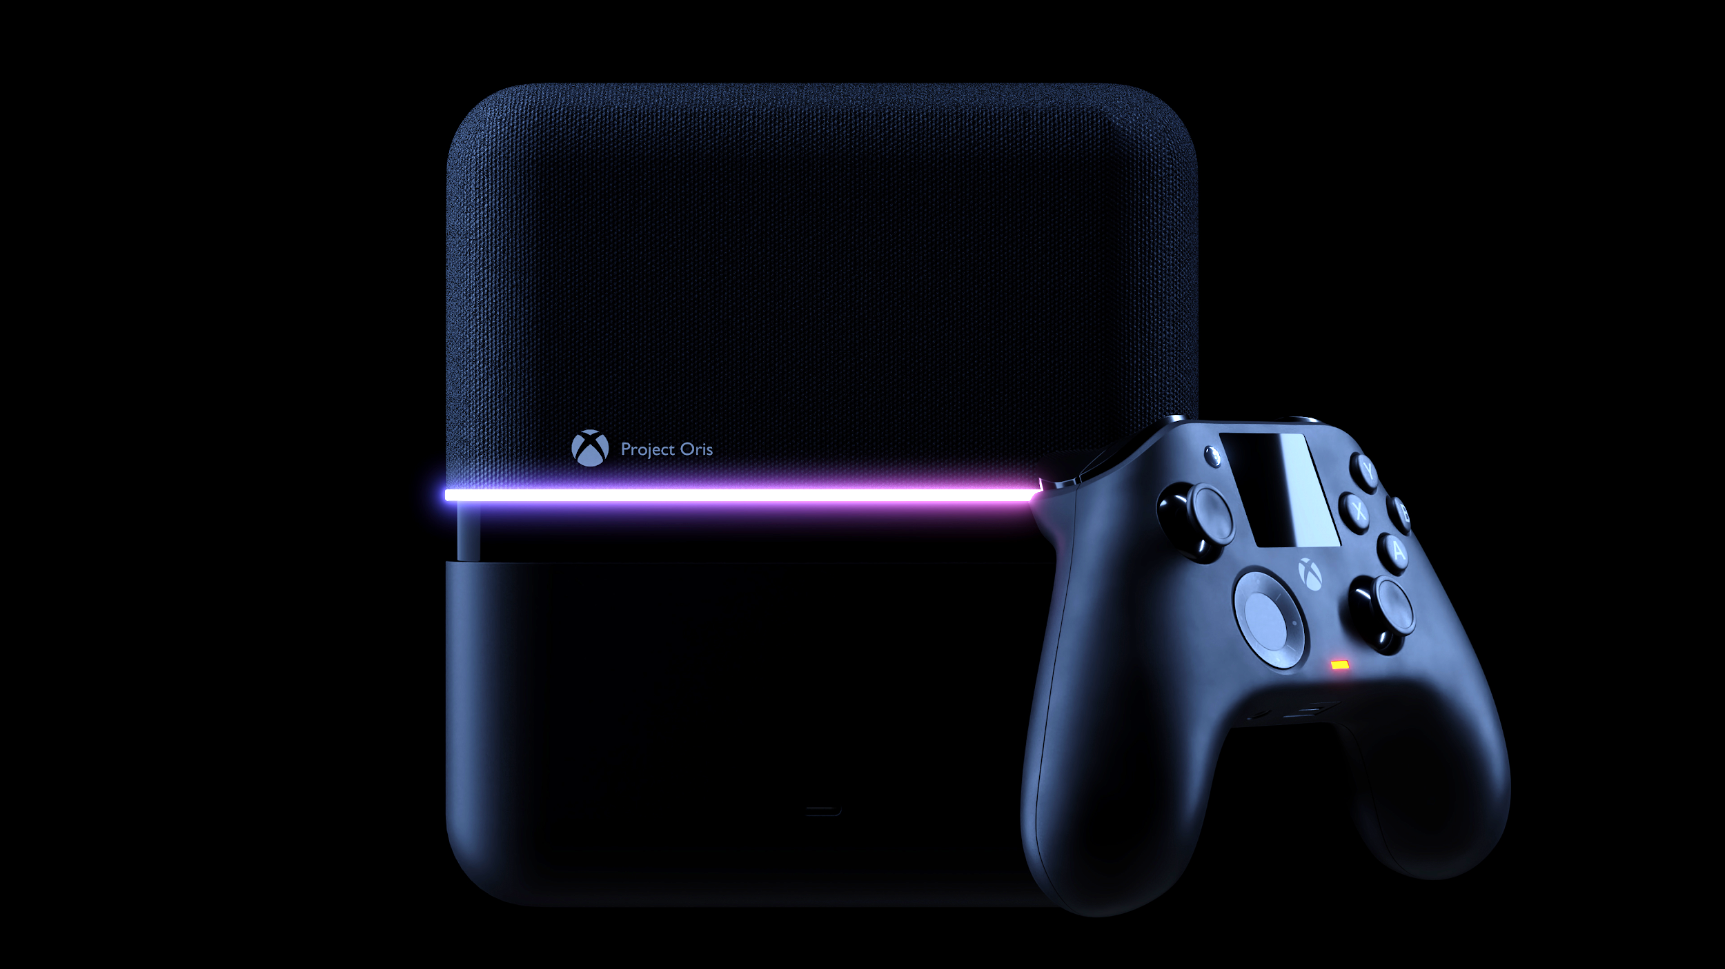
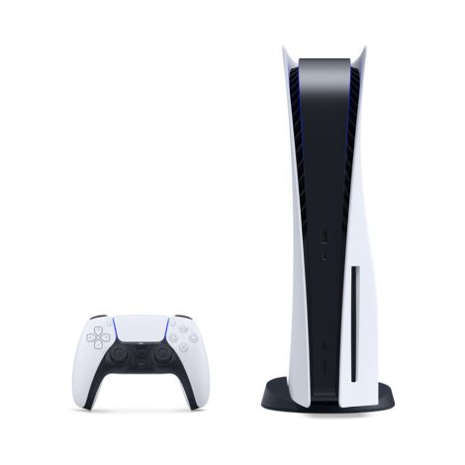
01
PROBLEM
WHY IT MATTERS
Notes:
Talk about two consoles. Xbox Series X and Playstation 5.
Both are releasing this fall.
Want to see how public feels about two consoles and report back to Microsoft and Sony.

Slide 4
Data Source
Comments of posts based on keywords “Xbox Series X” and “PS5” on reddit split across 4 demographics.
Hardcore Demographic: r/games
Casual Demographic: r/gaming
Dedicated Xbox fans: r/xboxone
Dedicated PS5 fans: r/PS5
Popular posts and comments obtained passing a certain upvote threshold.
Notes:
Introduce Reddit online forum.
Talk about why each demographic is segmented for each.
Popular posts and comments were scraped to gather popular sentiment.

Slide 5
Analytical Approach
General Subreddits
Casual and Hardcore Gaming Subreddits
Exploratory analysis through word frequency
PC showed up very frequently
Created a file with XBOX, PS5, PC and alternative names used for each
Created a list of attributes that people use qualify the consoles
Frequency analysis to get top 5 attributes
Lift Analysis
Console to Console
Console and attributes
Aspiration
Sentiment Analysis using vader
filter for XBOX
filter for PS5
Notes:
Word frequency yielded not that much.

Slide 6
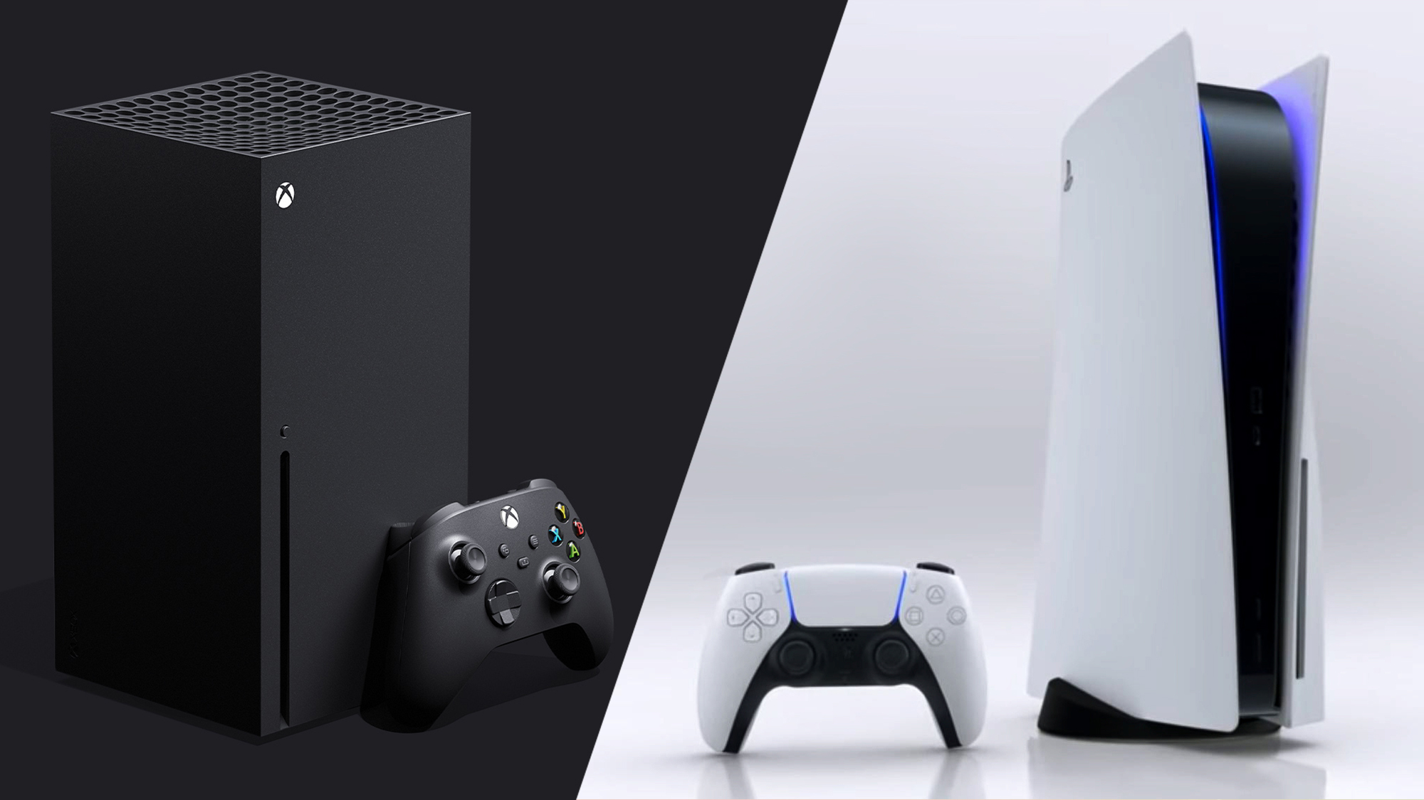
Analytical Approach
Dedicated Fan-bases Sub-reddits
Sub-Reddits forXbox & PS5
Frequency of attributes ( Top 5 )
General Word Frequency Analysis
Sentiment Analysis
Notes:
Word frequency yielded not that much.
Lift analysis did not make sense because it was nothing to compare it to. It was a segmented fan base for either the xbox or the PS5
Top 5 attributes were as mentioned
General word frequency analysis which was not really useful in this situation
Sentiment analysis using Vader
Using Vader lexicon we got the average sentiment and the sentiments for the top 5 attributes
Then we did the same for Fan base of PS5
We did the attribute frequency to get the top 5
General word frequency analysis which did not show us much and then went on to sentiment analysis using Vader compound scores
Getting the average sentiment and sentiments for each of the top 5 attributes and their means

Slide 7
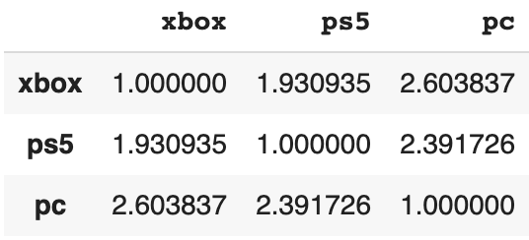
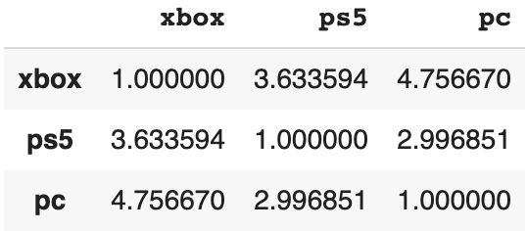
Console to Console Lift Analysis
Casual Gamers
Hardcore Gamers
Notes:
In casual gamers the xbox is compared more to pc than ps5 being compared to PC.
in Hardcore gamers xbox to pc was compared more in hardcore gamers and the ps5 was compared to xbox.

Slide 8
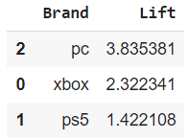
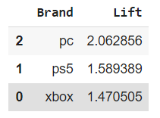
Aspirational Analysis
Casual Gamers
Hardcore Gamers
Notes:
Casual gamers prefer to buy a PC but When comparing just PS5 and XBOX, xbox would be more preferred.
Hardcore gamers also seem to prefer a PC but When comparing just PS5 and XBOX, PS5 is more preferred.

Slide 9

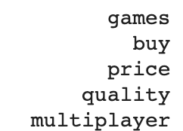
Top 5 Attributes
Casual Gamers
Hardcore Gamers
Notes:
Casual gamers would prefer to buy a PC. When comparing just PS5 and XBOX, xbox would win.
Hardcore gamers would prefer to buy a PC. When comparing jsust PS5 and XBOX, PS5 wins
One of the main reasons why PC seems to so popular is because PC’s seem to be more affordable and has other uses and not just gaming.

Slide 10
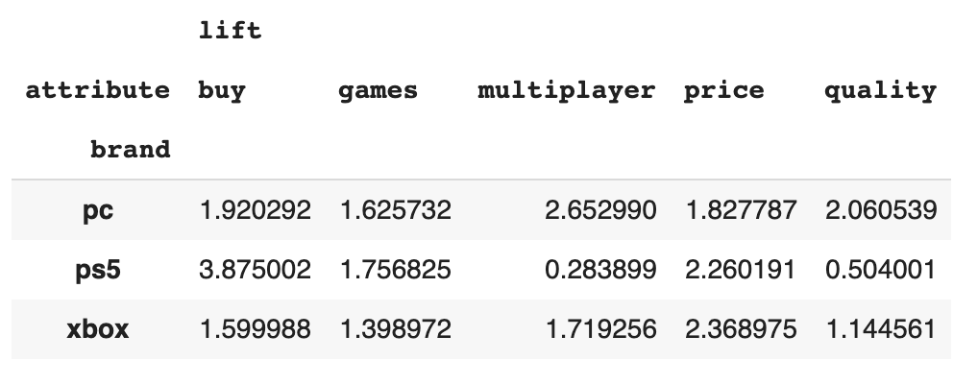
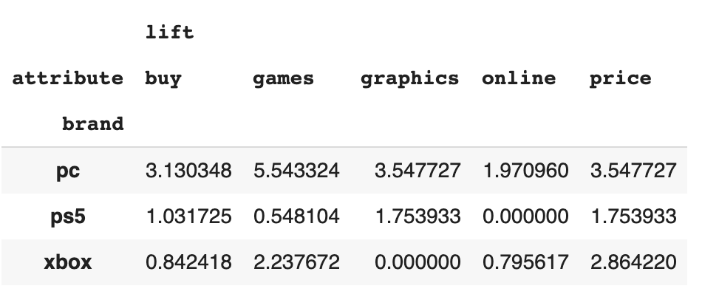
Attribute Lift Analysis
Casual Gamers
Hardcore Gamers
Notes:
We also conducted lift analysis for 5 frequent attributes selected from casual and hardcore gamer subreddits. For the casual gamer subreddit we found a notably high value lift value for the buy attribute of 3.87 for playstation 5 much higher than xbox , for hardcore gamers PS5 still beat out xbox in the buy attribute however, PC was actually the most dominant amongst hardcore gamers. Playstation 5 also had a very low lift value of .283 multiplayer games which makes logical sense as they tend to focus on single player games and graphics where Xbox tends to focus on multiplayer experience which corresponds to their lift score of 1.7. Additionally, price found higher lift values amongst both groups of gamers for the price attribute although noticably more for hardcore gamers.

Slide 11
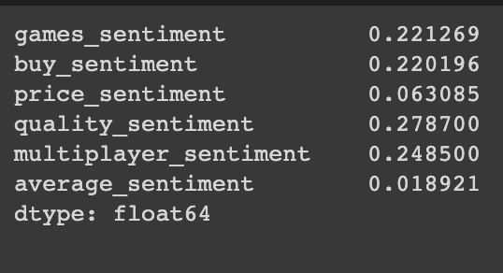
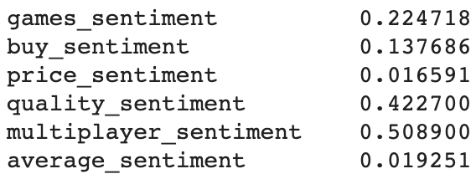
Sentiment Analysis
Hardcore Gamers
XBOX
PS5
Notes:
Next we decided to conduct sentiment analysis. A score close to 0 equates to a more neutral sentiment where the closer the vader score is to 1 the more positive the sentiment. This was our sentiment analysis for the hardcore gamers subreddit. For xbox; multiplayer, buy, games and quality attributes all had high positive sentiment where price is relatively neutral. Playstation had a very high multiplayer sentiment which is interesting as we normally relate playstation to single player games. Playstation quality sentiment is much higher than xbox which just shows playstation users value quality as a very important attribute.

Slide 12
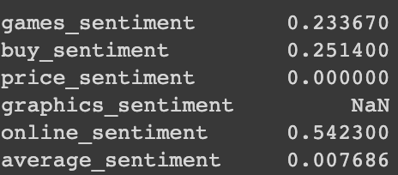
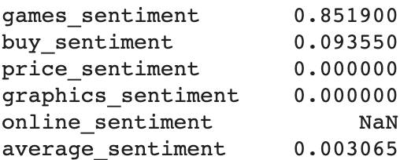
Sentiment Analysis
Casual Gamers
XBOX
PS5
Notes:
From the casual gamers subreddit xbox has a strong online sentiment of .54 where PS5 had 0 mentions of online attribute. This highlights again a major difference between the platforms where xbox tends to focus more on online multiplayer games where playstation gamers prefer high quality single player games. Additionally, for PS5 the sentiment for games is very strong and positive suggesting their selection of games is very optimal. Price sentiment is neutral for both which leads us to believe the pricing for xbox and ps5 are both pretty spot on.

Slide 13
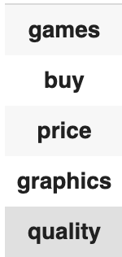
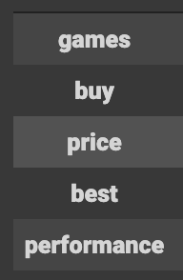
Top 5 Attributes
XBOX Fan-base
PS5 Fan-base
Notes:
We also found the top 5 attributes for xbox and ps5 fan bases. As you can see we found similar attributes for both.

Slide 14
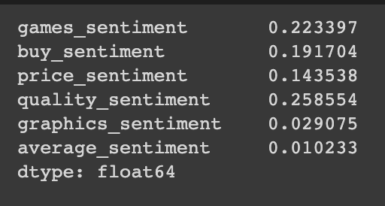
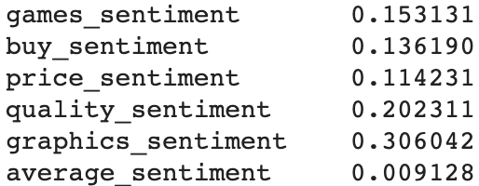
Sentiment Analysis
XBOX Fan-base
PS5 Fan-base
Notes:
and finally we have our analysis for top 5 attributes with fan bases. One thing to note is we used the xbox fan base for sentiment on the xbox and the ps5 fan base for sentiment on the play station as that makes the most sense. Among the xbox fan base they had the strongest positive feelings about the quality as far as xbox goes, followed by a positive sentiment about game selection. Also, both the buy and price sentiments were positive suggesting that the console is not over priced for the fan base..
Playstation 5 had the strongest sentiment with the graphics attribute, buy and price were also both positive sentiments again which allows us to also conclude that playstation is not over priced. Overall, from our analysis the fan bases bases seem to have a positive sentime, therefore we can conclude the fan bases are currently happy with both of their respective platforms.

Slide 15
Conclusion

Slide 16
01010100 01101000 01100001 01101110 01101011 00100000 01111001 01101111 01110101
THANK YOU!

